Slide 1
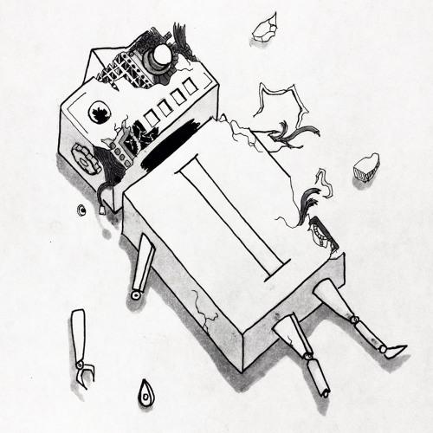
Industrialise ML
Version and unit test your data

Slide 2

Version your data
Test your data
Version your model

Slide 3
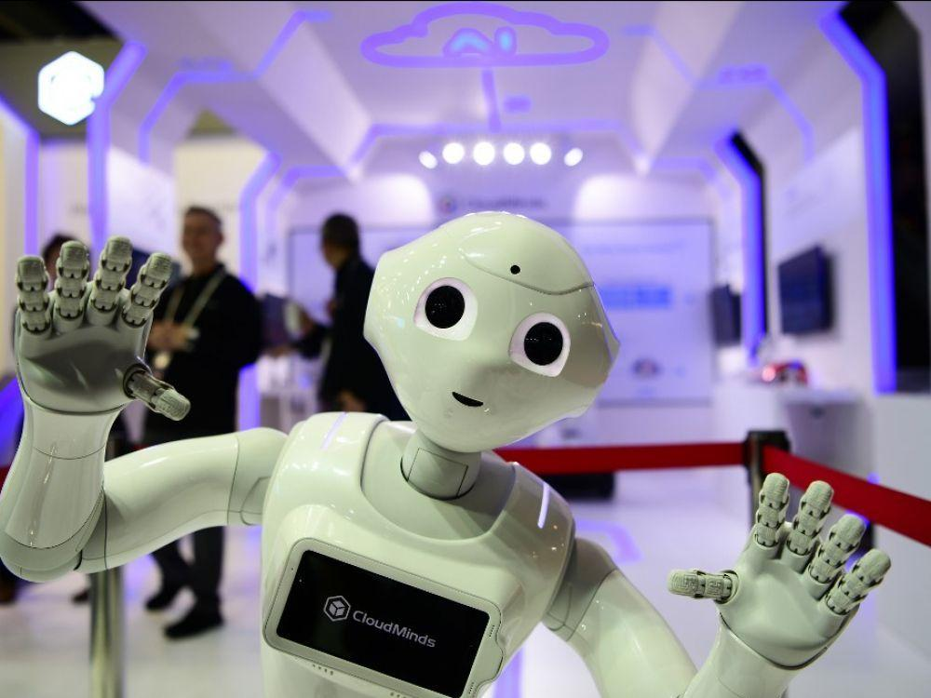
Build your environment

Slide 4
Go to https://databricks.com/try-databricks
Fill the fields and click “Get started for free”.
Follow the instructions
Click Compute > Create cluster
Enter a name and click Create cluster

Slide 5
Version your data

Slide 6
employees_for_history = DeltaTable.forPath(spark, "/mnt/delta/employee")
display(employees_for_history.history())

Slide 7
first_version_of_employees = spark.read.option("versionAsOf", 0).format("delta").load("/mnt/delta/employee")

Slide 8
Import blanks/deltalake
And
Replace x and function_to_replace

Slide 9
Test your data

Slide 10
df_ge.expect_column_distinct_values_to_be_in_set("Embarked", ["S", "Q", "C"])

Slide 11
Import the file “train.csv”
Import blanks/great_expectations
And
Replace function_to_replace
Don’t hesitate to play

Slide 12
Version your model

Slide 13
Import blanks/mlflow
And
Replace function_to_replace

Slide 14
import mlflow
mlflow.set_experiment("/Users/nastasia.saby@gmail.com/demo/iris_experiments")
with mlflow.start_run() as last_run:
mlflow.log_metric("accuracy", 0.7)
mlflow.log_param("degree", 0.6)
mlflow.sklearn.log_model(model, "Iris")

